Slide 1
The Relationship Between Inflation and Unemployment (Phillips curve) in the US
Kanika Jain
Sahr Musa
Steven Rodriguez
Taurean Hutchinson
Notes:
Sahr Musa

Slide 2
Motivation & Summary
The aim of our project is to establish the relationship between inflation and unemployment (the Phillips curve) in the US. We'll rely on the time series data that we have to examine the interconnectedness between general inflation rates and unemployment rates .
Our motivation for this topic was the alarming rate of unemployment in the US currently. We wanted to analyze the different economic effects that this rate of unemployment has and its historical effects.
Notes:
Sahr Musa

Slide 3
Questions & Data
Q1: Analysis over Time
Q2: Analysis of Phillips Curve
Q3: Analysis of GDP
Q3: Analysis by State
Unemployment over Time
Inflation over time
Unemployment over time vs Inflation over time - Line Graph
Unemployment over time vs Inflation over time - Regression Analysis
Cross Section Analysis (1947-1983) and (1984-2019)
Relationship between Unemployment and GDP
Q2: Analysis of Phillips Curve
Q4: Analysis by State
Unemployment by selected states
New Jersey State Analysis
Florida State Analysis
Notes:
Sahr Musa

Slide 4
Data Analysis
THE DATA
Federal Reserve Economic Data (FRED) https://fred.stlouisfed.org/
FRED API
Inflation CSV
Bureau of Labor Statistics (BLS)
Notes:
Sahr Musa

Slide 5
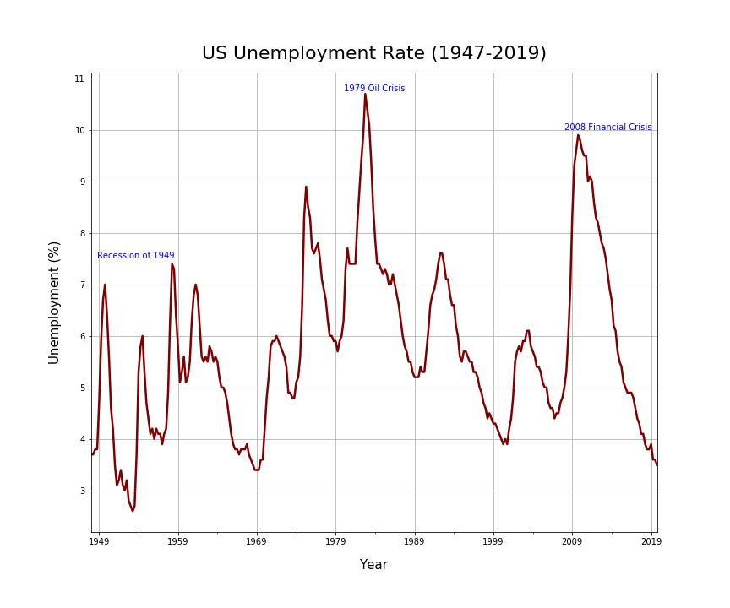
Q1: Analysis
Over Time
Unemployment over Time
Analysis:
Unemployment rate across the business cycle slumped in the mid 40s and rose sharply due to the recession of the 1950s
Between 1959 and 1979, a possible bouncing back of the economy from the previous recession saw relative low rates of unemployment.
Unemployment rates rose significantly during the oil (1979) and financial crises(2008), with relative low unemployment between the two economic shocks periods.
Notes:
Sahr Musa

Slide 6
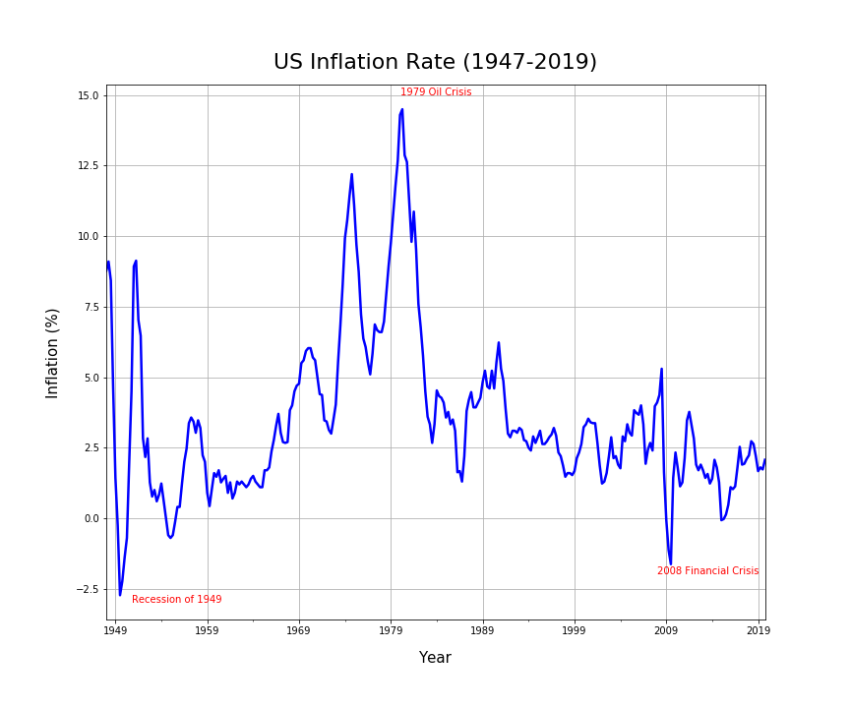
Q1: Analysis
Over Time
Inflation
over Time
Analysis:
The highest Inflation occured around 1882 at 14.75%
The 1979 Oil Crisis was a big influence for the high inflation period
Higher inflation will always reduce the value of money & savings
The lowest inflation occured around 1950 at -2.6%
The Recession of 1949 influenced the low inflation period
Negative inflation = Deflation
Worse than Inflation since assets and consumer prices fall over time
Notes:
Sahr Musa

Slide 7
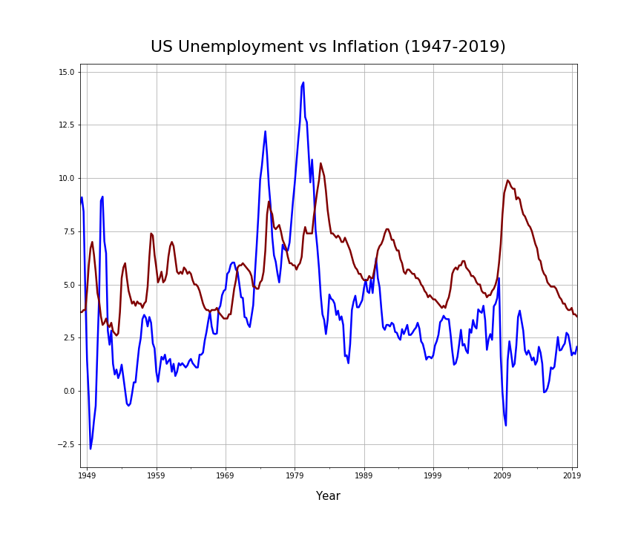
Q2: Analysis
Of Phillips Curve
Unemployment over time vs Inflation over time for the US - Line Graph
Analysis:
Unemployment (Red Line) and Inflation (Blue Line)
Seasonality following Time Series
High unemployment would be followed by either High inflation or dipping into Deflation
The 2008-2009 financial crisis shot up unemployment, and turned a positive Inflation rate into Deflation
Notes:
Kanika

Slide 8
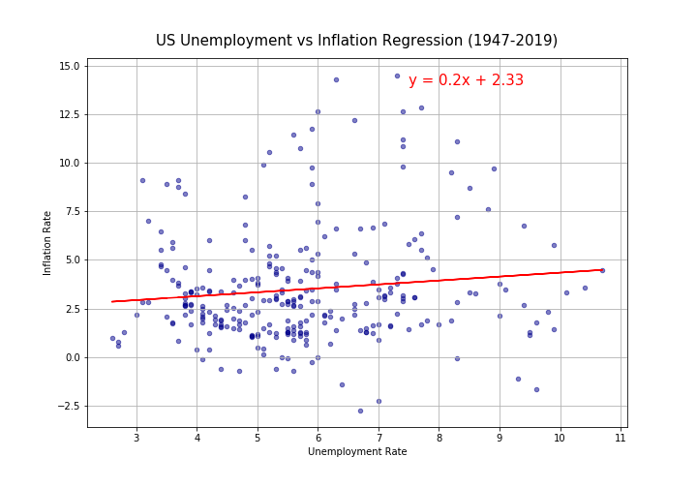
Q2: Analysis
Of Phillips Curve
Unemployment over time vs Inflation over time for the US - Regression Analysis
Analysis:
Our initial findings suggest that the negative relationship assumed by the Phillips curve does not hold
The results show a slightly positive relationship
Notes:
Kanika
The coefficient is not statistically significant

Slide 9
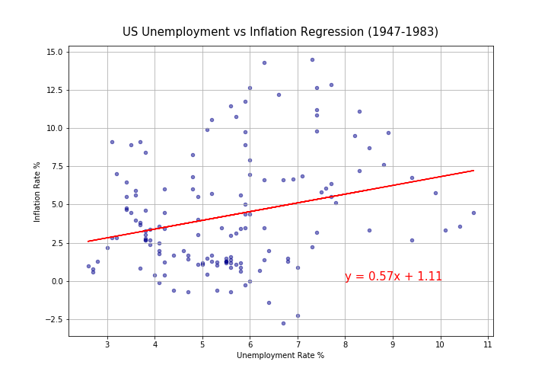
Cross Section Analysis:
1947 - 1983
Data broken up into 2 sections: 1947-1983 and 1984 to 2020
Results: Positive relationship, disproving Phillips Curve
During this time the US was very prosperous economically, the baby boomer generation enjoyed great job opportunities and this reflects in the positive change.
By 1983, the economy had rebounded and the United States entered into one of the longest periods of sustained economic growth since World War II. The annual inflation rate remained under 5 percent from 1983 through 1987.
Notes:
Steven
Not statistically significant

Slide 10
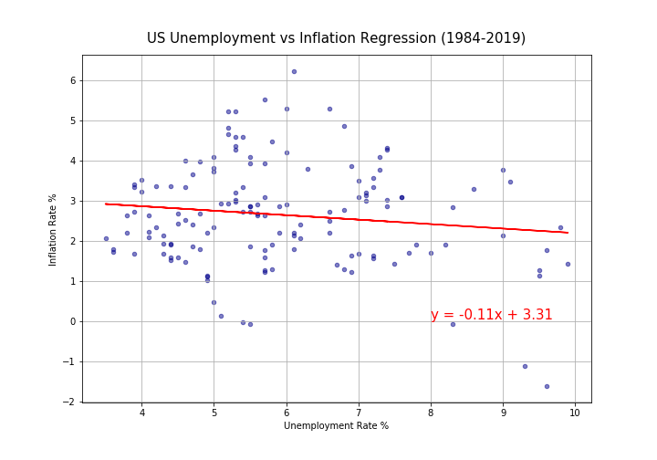
Cross Section Analysis:
1984 - 2019
Results: Negative relationship, proving Phillips Curve
1984-2019 reflected the recession and change in leadership in the US resulting in a downwards curve.
Notes:
Steven
Statistically significant at the 10% level

Slide 11
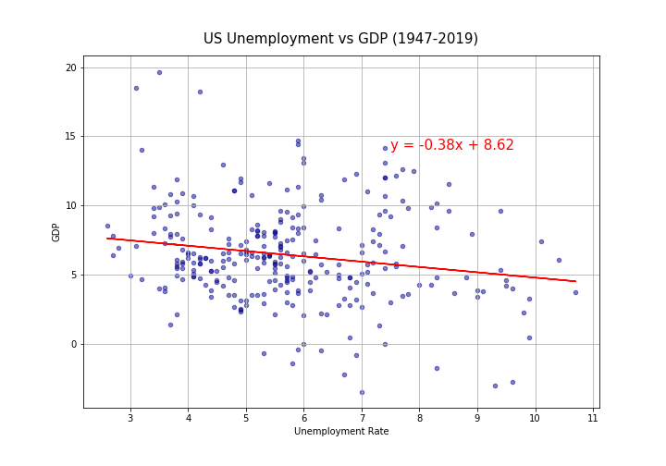
Q3: Analysis
Of GDP
Regression with Unemployment on GDP
Analysis:
Okun’s Law: a percentage increase in unemployment should lead to a GDP decrease by 2%
A country's GDP must grow at about a 4% rate for one year to achieve a 1% reduction in the rate of unemployment.
This analysis supports that negative relationship
Statistically significant at the 5% level
Notes:
Steven
Statistically significant at the 5% level

Slide 12
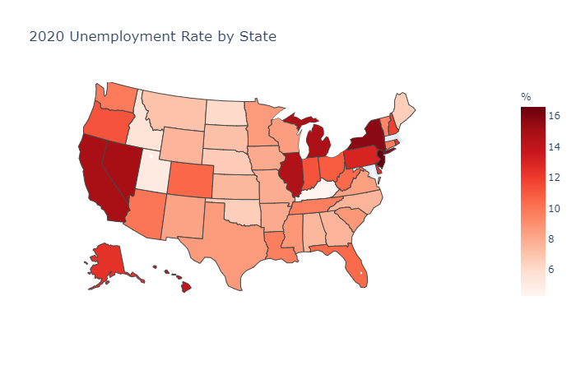
Q4: Analysis
By State
Unemployment by State
Analysis:
Most recent Unemployment data by state - July 3rd, 2020
New Jersey highest: 16.6%
Kentucky lowest: 4.3%
Notes:
Taurean
Latest data, affected by the pandemic

Slide 13
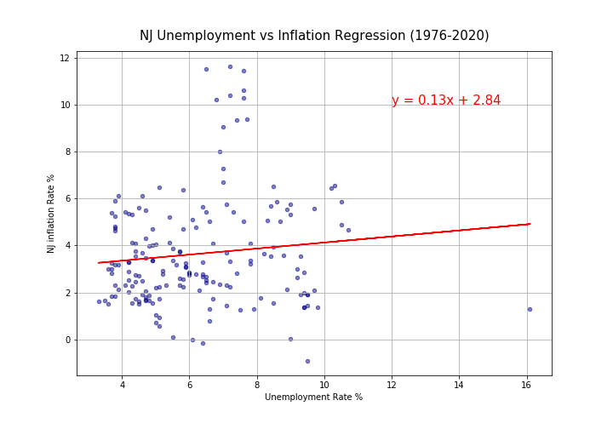
Q4: Analysis
By State -
New Jersey
We will use the analysis on the US on 2 selected states: New Jersey and Florida
Phillips curve relationship does not hold for NJ
We once again obtain similar results from the US analysis, where we get a positive relationship in one case and a negative in another.
Notes:
Taurean
Statistically significant at the 10% level

Slide 14
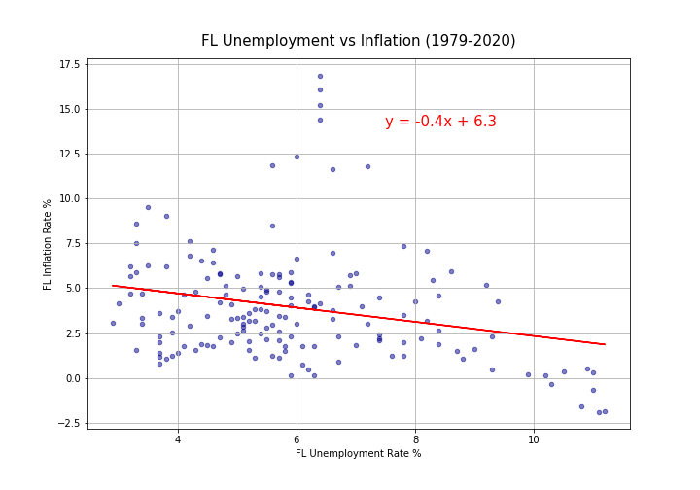
Q4: Analysis
By State -
Florida
For Florida we can see that there is a negative relationship that exists, therefore the Phillips Curve assumption does hold
Notes:
Taurean
Statistically significant at the 5% level
What conclusions can be drawn from the US and States analysis: There are underlying factors that will have different effects on variable during different time periods and also within different states

Slide 15
Discussion - Trend Analysis / Findings
Phillips Curve
We found relationships that exhibit the Phillips Curve negative relationship in some cases, but also there were results that disproved it. Therefore there is still ambiguity surrounding the validity of this theory which supports current research.
GDP
Proved Okun’s Law by supporting a negative relationship between GDP and Unemployment
Aggregate analysis vs the singular state analysis showed very similar results where certain underlying factors caused the negative relationship to hold between unemployment and inflation vs the cases where this condition did not prove to be true. Further analysis including controlling for other variables may need to be implemented for further analysing this relationship.
US vs US States
Notes:
Taurean

Slide 16
Post Mortem
Difficulties
Solutions
Additional Inferences
Cleaning up the code and merging different data sources
Obtaining and utilizing maps data for analysis
Step-by-Step organization of code
Learning to change data types of fields to merge
Creating a new dataframe for maps data
Deeper dive analysis for Phillips Curve per State
Statewide vs US
Perform more in depth cross sectional analysis
Had trouble with code, more time to fix
Notes:
Taurean

Slide 17


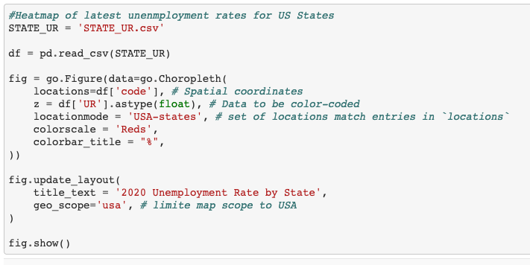
Data Cleanup & Exploration
Retrieve data using FRED apis and Bureau of Labor Statistics
Modify data by merging and changing variable classes
Issues with using plotly and mapping data
Cross sectioning data helped further analysis
Notes:
Kanika

Slide 18
Questions?
Notes:
Kanika

